Slide 1
Code Description

Slide 2
Reference paper review
CNN Based Approach for Traffic Sign Recognition System Karan Singh1, Nikita Malik2; Advance Journal of Graduate Research ISSN: 2456-7108; https://doi.org/10.21467/ajgr.11.1.23-33
Major Highlights:
Multi-Label Classification
A CNN model based on a modified LeNet architecture (4 convolutional layers, 2 max-pooling layers and 2 dense layers.
Trained and tested with the German Traffic Sign Recognition Benchmark (GTSRB) dataset.
Used Adaptive Moment Estimation (Adam), a gradient-based approach.

Slide 3
CNN Methodology
Setting up working environment and Libraries
Dataset Generation
Preprocessing the images
Splitting the Datasets
Building a Convolutional Neural Network
Training the model
Plotting the Performance parameters
Evaluation
Testing the model

Slide 4
Reference paper Review
No. of Classes: 43 Different Traffic Signs
Divided into Test and Train Folders
Train Dataset Images: 39209; Test Dataset Images: 12630
Random images from size 15X15 to 250X250 pixels

Slide 5
Training Images with Labels Samples:
Training Images Size: (39209, 30, 30)

Slide 6
CNN Model Summary

Slide 7
Performance Metrics
CNN Trained Model metrics:
Model_Accuracy: 97.8%
Valida􀆟on_images accuracy: 98.9

Slide 8
Sample Test Image with Prediction

Slide 9
Confusion matrix for the Tested Model
Test Images:
Performance Metrics:
Accuracy: 0.965558
Precision: 0.948335
Recall: 0.946038
F1 score: 0.945373

Slide 10
Our Code Objective
Train the German Traffic Data Sign Model only for 5 Classes for our Robot using the model as a proposed by the reference paper
The Five signs include:
Turn Left Ahead
Turn Right Ahead
Stop
Speed Limit 20
Speed Limit 60

Slide 11
Our Code Description
Image Preprocessing:
Images resized: 80X80
Converted to GrayScale
Smoothing out
5 classes and 5 labels
The images for training are iterated and saved as a NumPy array.
Dataset split: 80% for training and 20 % for validation.
One hot Encoding method performed (Each image represented as binary vector of categorical class)
Employs Adam optimizer and the categorical cross entropy loss function during training.
No. of batches: 64; No. of Epochs: 20

Slide 12
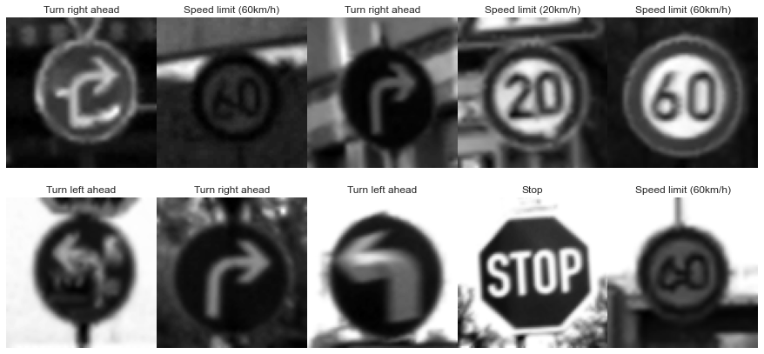
Training Images with Labels Samples:
Training Images Size: (1110, 80, 80)

Slide 13
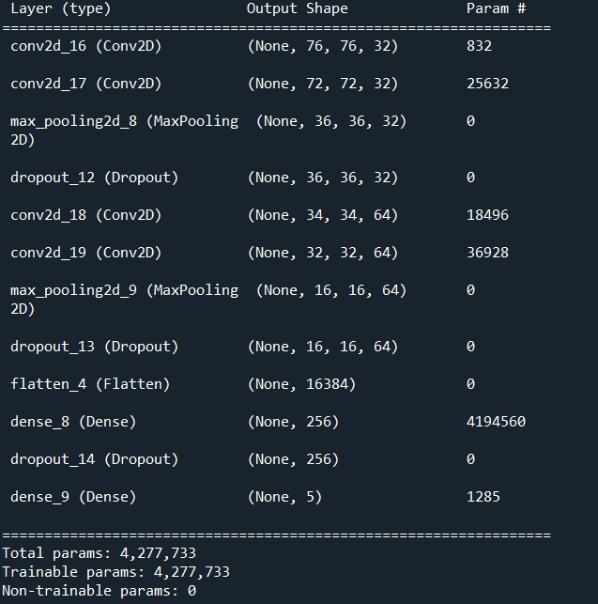
CNN Model Summary

Slide 14
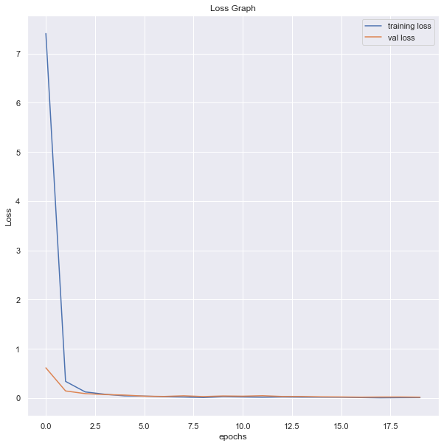
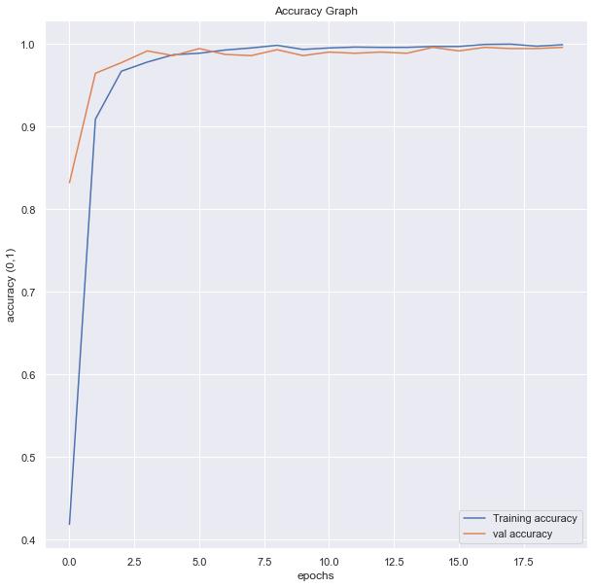
Performance Metrics
CNN Trained Model metrics:
Model_Accuracy: 99.89%
Validation_set_Accuracy: 99.57%

Slide 15
Test Performance metrics (5 classes Model)
No. Test images: 1110
Test_accuracy: 98.28%
Test-Precison : 97.79%
Test_Recall: 97.99%
Test_F1-Score: 97.94%
Class Labels | Precision | Recall | F1-score | No. of Test_Images
Turn Left Ahead (0) | 0.96 | 0.99 | 0.98 | 120
Turn Right Ahead (1) | 1.00 | 0.99 | 0.99 | 210
Stop (2) | 1.00 | 0.96 | 0.98 | 270
Speed Limit 20 (3) | 0.97 | 0.97 | 0.97 | 60
Speed Limit 60 (4) | 0.98 | 1.00 | 0.99 | 450
 |  |  |  | 1110

Slide 16
Robot Model Recognition Methodolgy
Capture each image frame from our mobile camera
Convert to Grayscale
Gaussian Blur Operation
Image Thresholding/ Canny Image Edge Detection
Find Contours
Create a Bounding Rectangle for contours for 4 ends
Compute Aspect ratio
Compute the
Crop the image using Square Bounding box co-ordinates
Send the Cropped Image to our trained Model
Display the Detection and Recognition Result

Slide 17


